Slide 1

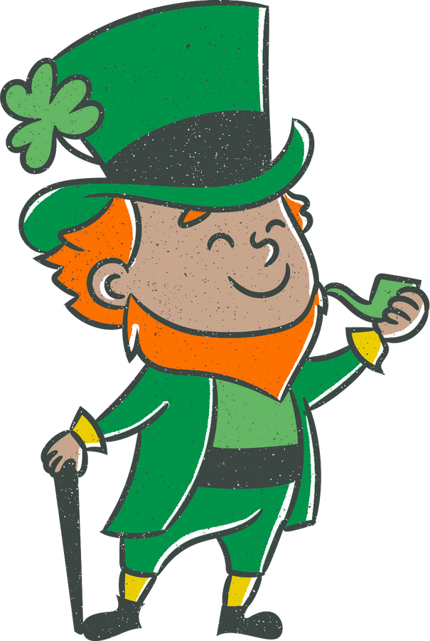
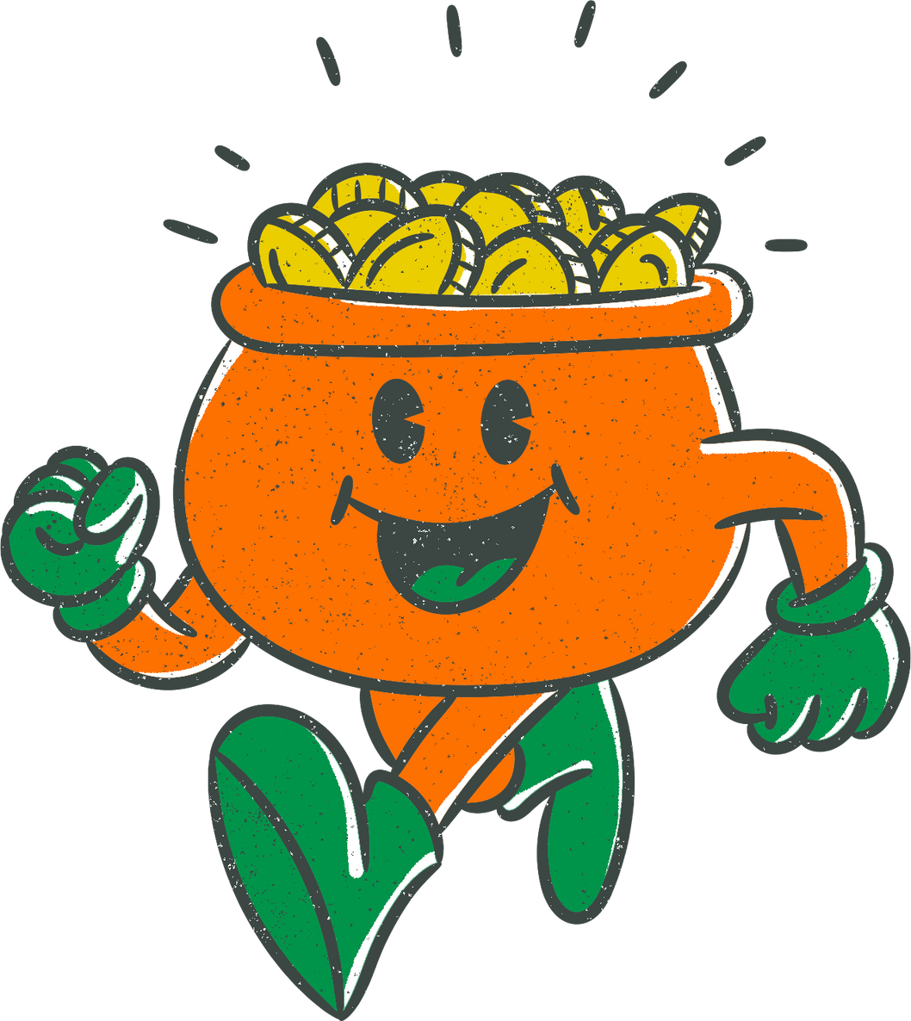
Idiomatic Expressions

Slide 2
Idiomatic expressions are groups of words with an established meaning unrelated to the meanings of the individual words.
Some common idiomatic expressions:
•He let the cat out of the bag (accidentally told a secret).
•She got off Scott-free (escaped without punishment).
•He flew off the handle (went crazy).

Slide 3
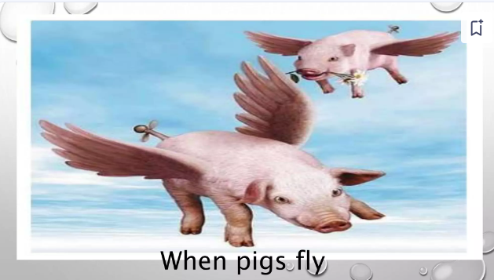
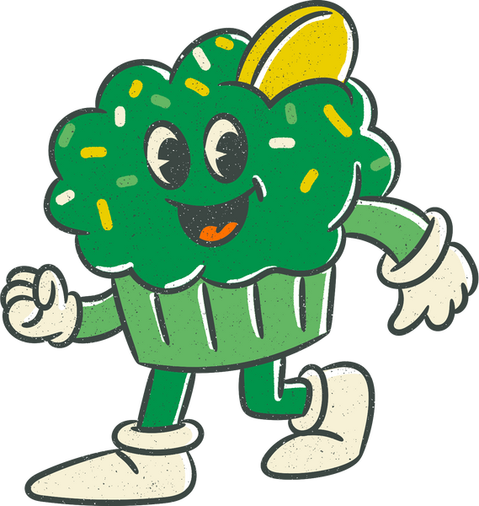
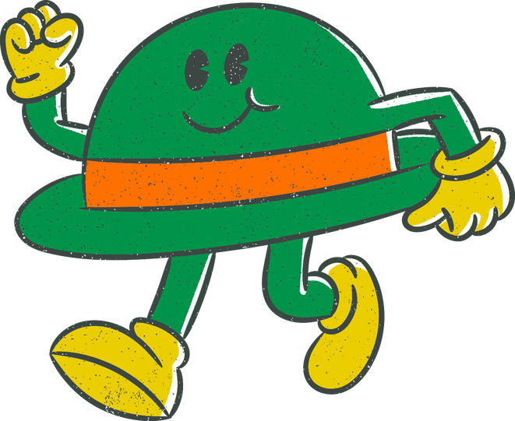
'When Pigs Fly' refers to something that is highly unlikely to ever happen. .

Slide 4
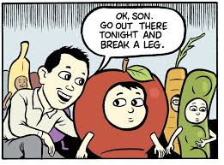
Break a leg
To break a leg means to wish someone good luck.

Slide 5
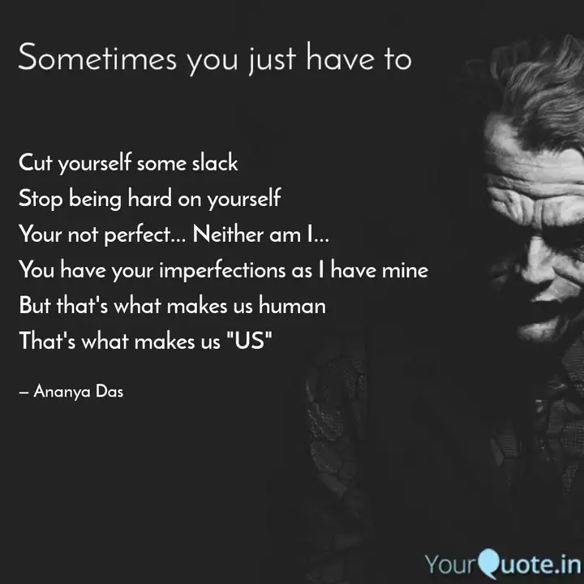
Cut some slack
It means to not be harsh with someone or to give some freedom.

Slide 6
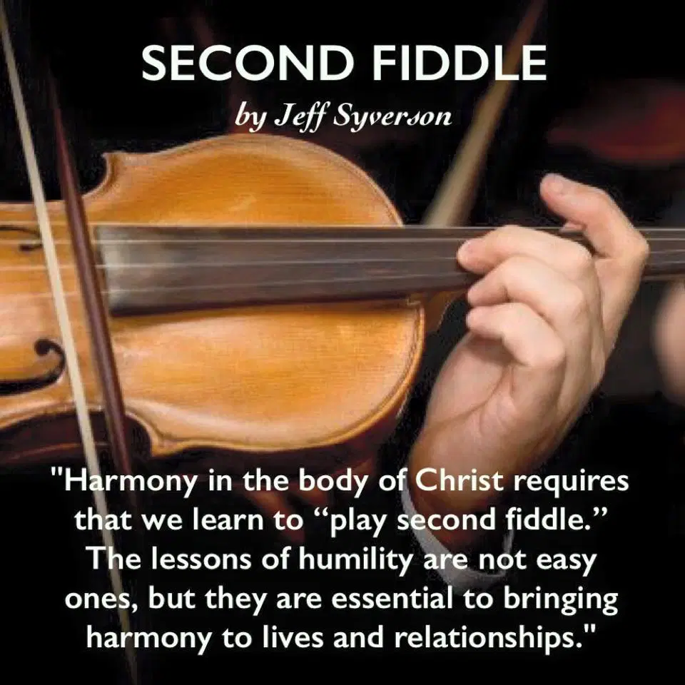
Play second fiddle to someone
a person influencing or manipulating others for their own benefit.

Slide 7
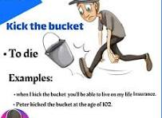

Slide 8
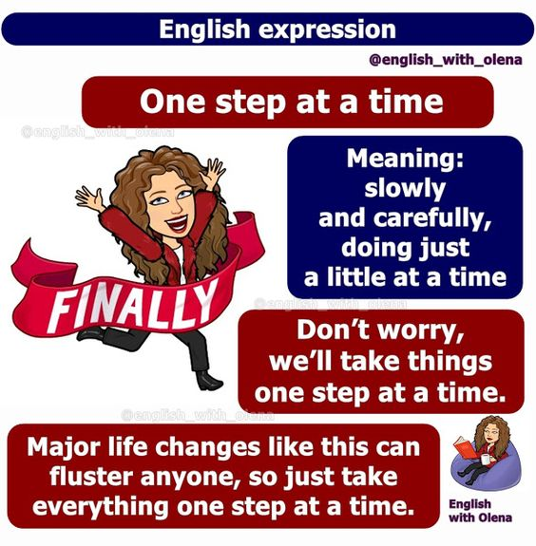

Slide 9
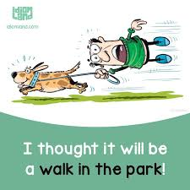
Guess the meaning

Slide 10
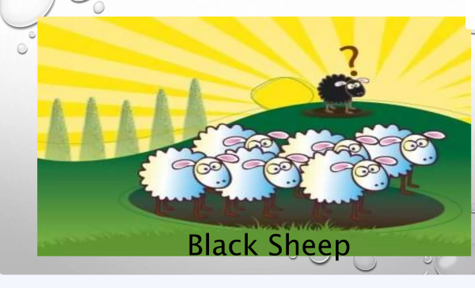

Slide 11
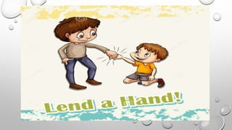

Slide 12
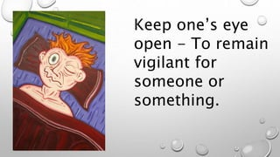

Slide 13
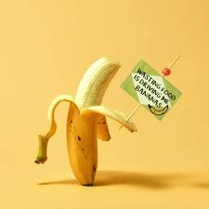
Driving me bananas
He is driving me bananas; That means he is making me go crazy.
For example,
Varun Dhawan running faster than the train while on top of it in his recent movie was driving me bananas.

Slide 14
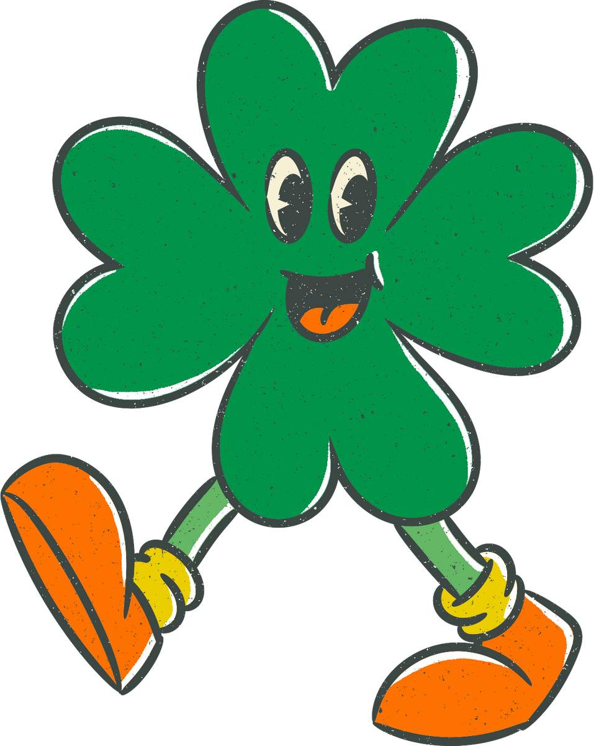
Let’s Practice
.

Slide 15
Beginner's luck
a) The luck that someone has when they are new to something.
b) The bad luck that someone has when they are new to something.
c) The luck that someone has when they are experienced at something.

Slide 16
Beginner's luck
a) The luck that someone has when they are new to something.
b) The bad luck that someone has when they are new to something.
c) The luck that someone has when they are experienced at something.

Slide 17
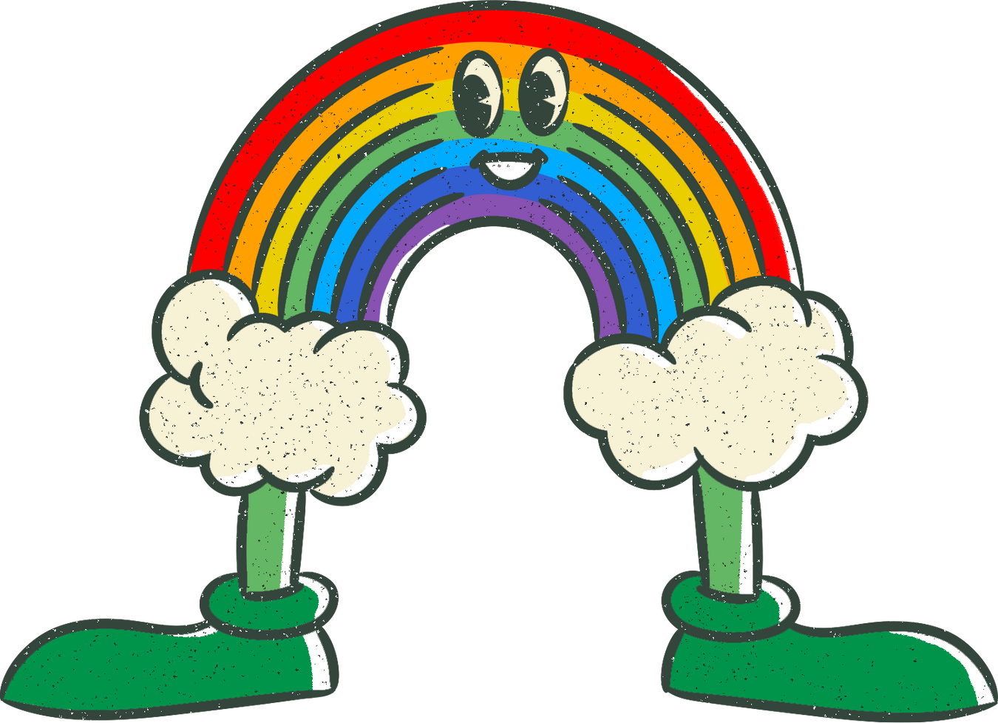
Chase rainbows
a) To look for a pot of gold at the end of a rainbow.
b) To pursue an unrealistic or impossible goal.
c) To enjoy good luck or fortune.

Slide 18
Chase rainbows
a) To look for a pot of gold at the end of a rainbow.
b) To pursue an unrealistic or impossible goal.
c) To enjoy good luck or fortune.

Slide 19
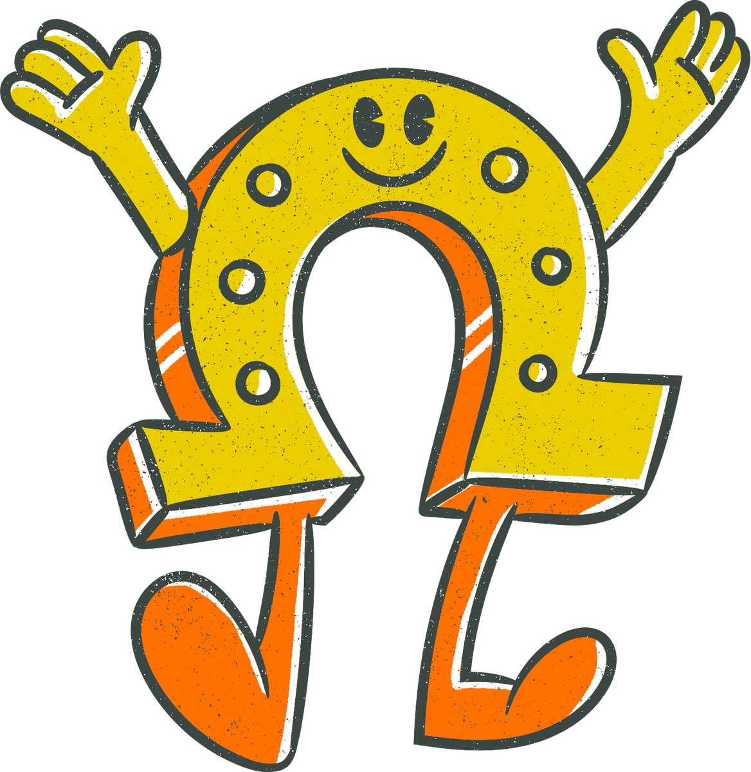
Be in/out of luck
a) To have good luck/bad luck.
b) To be looking for luck.
c) To be unsure if one will have luck.

Slide 20
Be in/out of luck
a) To have good luck/bad luck.
b) To be looking for luck.
c) To be unsure if one will have luck.

Slide 21
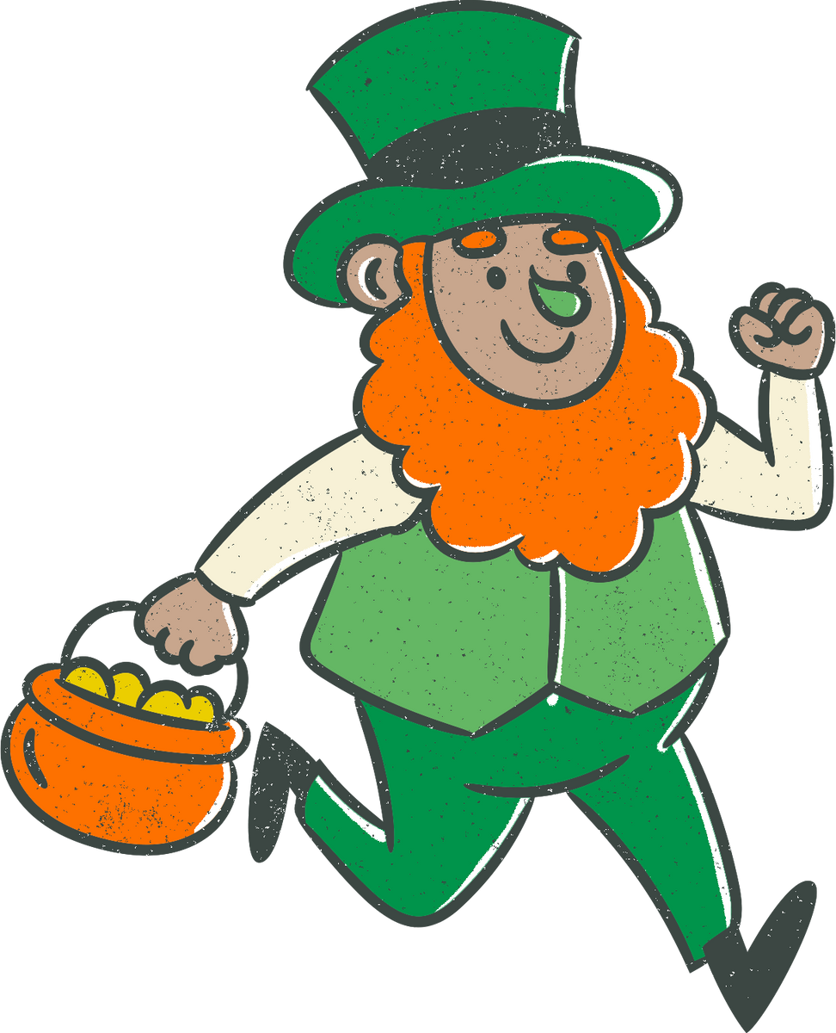
A golden opportunity
a) A chance to make a lot of money.
b) An opportunity that is rare and valuable.
c) An opportunity to show off one's skills.

Slide 22
A golden opportunity
a) A chance to make a lot of money.
b) An opportunity that is rare and valuable.
c) An opportunity to show off one's skills.

Slide 23
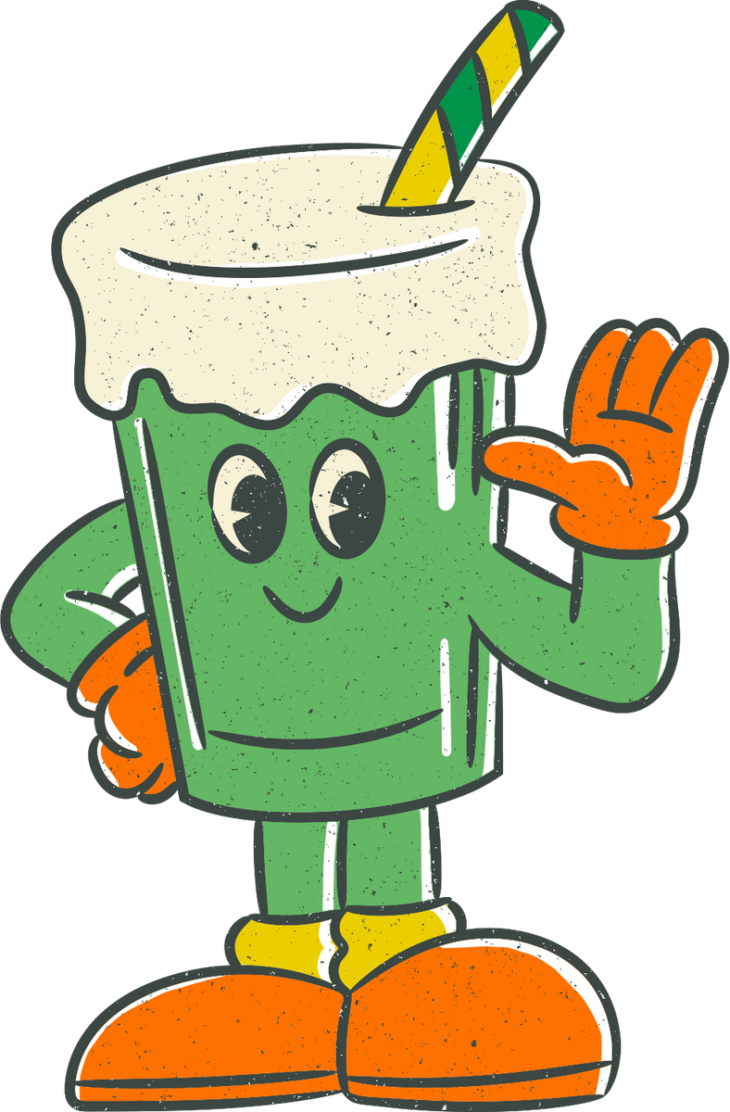
The luck of the draw
a) The process of choosing random winners from a pool of contestants.
b) The luck that someone has in a particular situation that is beyond their control.
c) The process of selecting the luckiest person from a group.

Slide 24
The luck of the draw
a) The process of choosing random winners from a pool of contestants.
b) The luck that someone has in a particular situation that is beyond their control.
c) The process of selecting the luckiest person from a group.

Slide 25
Hit the jackpot
a) To win a large amount of money or have great success.
b) To have bad luck or fail at something.
c) To be successful when one starts a new activity.

Slide 26
Hit the jackpot
a) To win a large amount of money or have great success.
b) To have bad luck or fail at something.
c) To be successful when one starts a new activity.

Slide 27
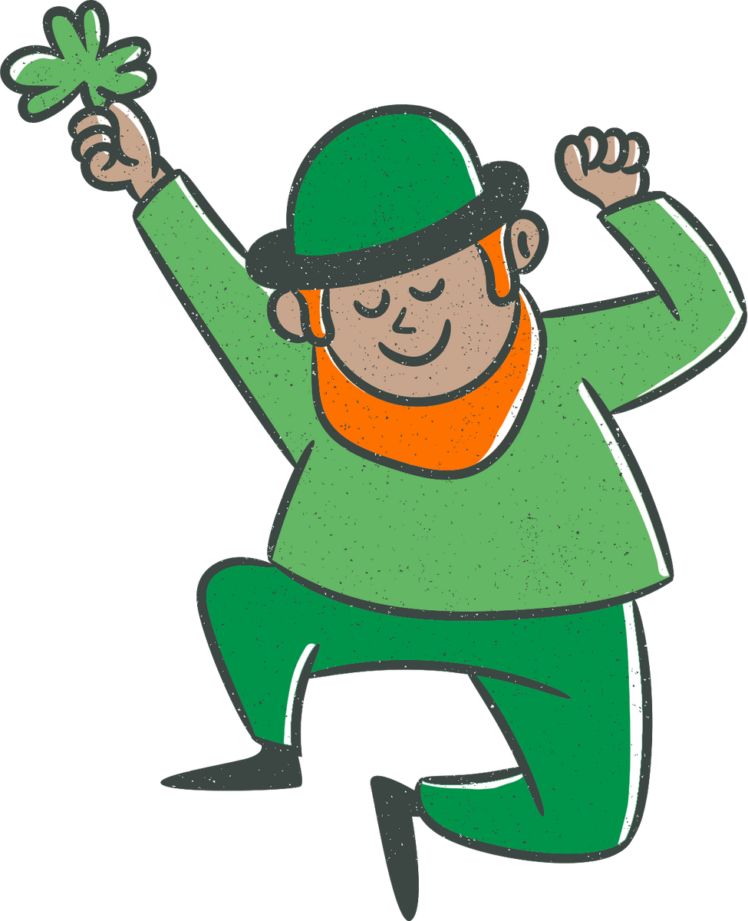
To push one's luck
a) To take advantage of good luck or fortune.
b) To continue to do something risky or dangerous, despite having been lucky so far.
c) To try too hard to make something happen, risking one's chances of success.

Slide 28
To push one's luck
a) To take advantage of good luck or fortune.
b) To continue to do something risky or dangerous, despite having been lucky so far.
c) To try too hard to make something happen, risking one's chances of success.

Slide 29
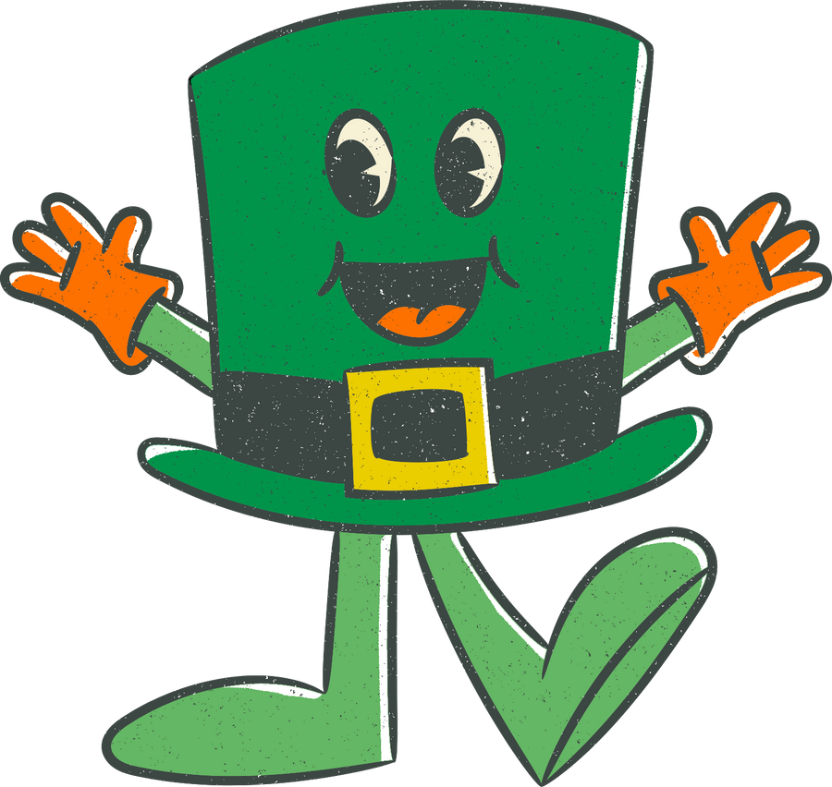
To pull something out of a hat
a) To perform a magic trick that involves pulling something out of a hat.
b) To come up with a surprising or unexpected solution or idea.
c) To hide something in a hat.

Slide 30
To pull something out of a hat
a) To perform a magic trick that involves pulling something out of a hat.
b) To come up with a surprising or unexpected solution or idea.
c) To hide something in a hat.

Slide 31
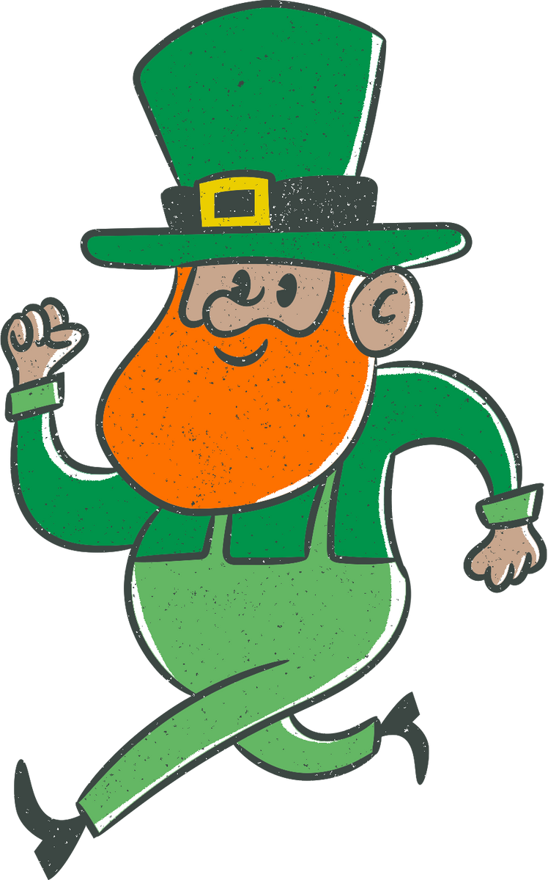
The luck of the Irish
a) The idea that Irish people are naturally lucky.
b) The good fortune that is associated with St. Patrick's Day.
c) The belief that luck is random and not influenced by one's nationality.

Slide 32
The luck of the Irish
a) The idea that Irish people are naturally lucky.
b) The good fortune that is associated with St. Patrick's Day.
c) The belief that luck is random and not influenced by one's nationality.

Slide 33
